Slide 1
Second Year B. Tech. Advanced Data Structures (CS228)
By
Dr. Pramod D. Ganjewar
Senior Assistant Professor,
School of Computer Engineering,
MIT Academy of Engineering, Alandi(D.),Pune

Slide 2
Unit – 1 Trees Binary Trees Traversals

Slide 3
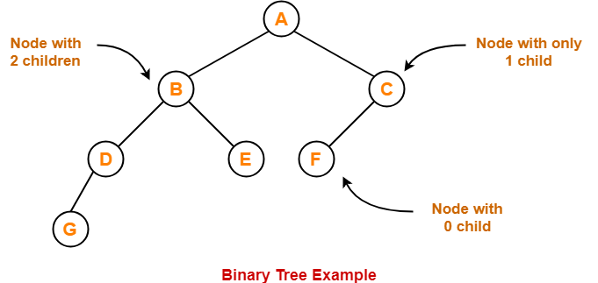
Binary Tree
Binary Tree
Binary tree is a special tree data structure in which each node can have at most 2 children.
Thus, in a binary tree, Each node has either 0 child or 1 child or 2 children.

Slide 4
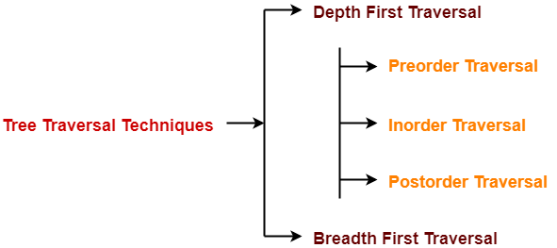
Binary Tree Traversals
Tree Traversal refers to the process of visiting each node in a tree data structure exactly once.
Various tree traversal techniques are –
Depth First Traversal
Preorder Traversal
In-order Traversal
Post-order Traversal
Breadth First Traversal

Slide 5
Depth First Traversals
Depth First Traversal-
Following three traversal techniques fall under Depth First Traversal-
Preorder Traversal
In-order Traversal
Post-order Traversal

Slide 6
Pre-Order Traversals
Algorithm-
Visit the root
Traverse the left sub tree i.e. call Preorder (left sub tree)
Traverse the right sub tree i.e. call Preorder (right sub tree)
Root → Left → Right

Slide 7
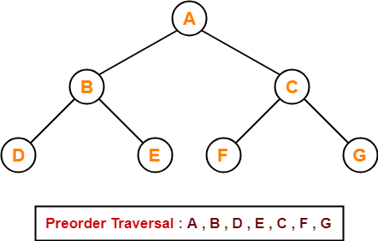
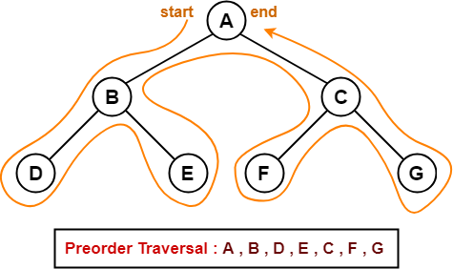
Pre-Order Traversals
Preorder Traversal Shortcut
Traverse the entire tree starting from the root node keeping yourself to the left.
Example
Consider the following example-

Slide 8
Pre-Order Traversals
Applications
Preorder traversal is used to get prefix expression of an expression tree.
Preorder traversal is used to create a copy of the tree.

Slide 9
In-Order Traversals
Algorithm-
Traverse the left sub tree i.e. call Inorder (left sub tree)
Visit the root
Traverse the right sub tree i.e. call Inorder (right sub tree)
Left → Root → Right

Slide 10
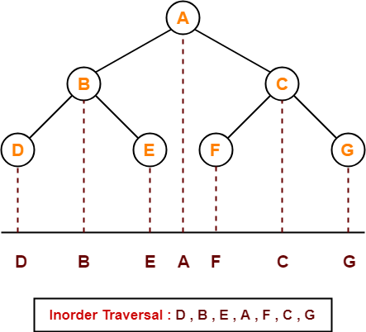
In-Order Traversals
In-order Traversal Shortcut
Keep a plane mirror horizontally at the bottom of the tree and take the projection of all the nodes.
Example
Consider the following example-

Slide 11
In-Order Traversals
Applications
In-order traversal is used to get infix expression of an expression tree.

Slide 12
Post-Order Traversals
Algorithm-
Traverse the left sub tree i.e. call Postorder (left sub tree)
Traverse the right sub tree i.e. call Postorder (right sub tree)
Visit the root
Left → Right → Root

Slide 13
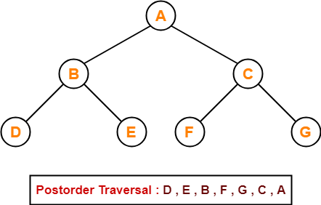
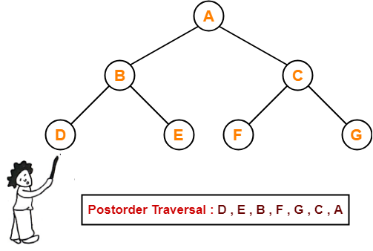
Post-Order Traversals
Post-order Traversal Shortcut
Pick all the leftmost leaf nodes one by one.
Example
Consider the following example-

Slide 14
Post-Order Traversals
Applications
Post-order traversal is used to get postfix expression of an expression tree.
Post-order traversal is used to delete the tree. This is because it deletes the children first and then it deletes the parent.

Slide 15
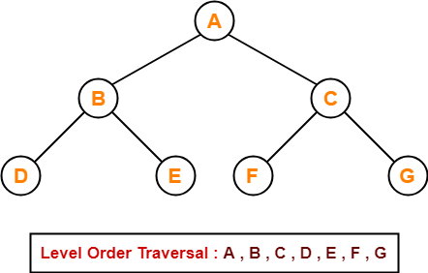
Breadth First Traversals
Breadth First Traversal of a tree prints all the nodes of a tree level by level.
Breadth First Traversal is also called as Level Order Traversal.
Example - Consider the following example-

Slide 16
Breadth First Traversals
Applications
Level order traversal is used to print the data in the same order as stored in the array representation of a complete binary tree.

Slide 17
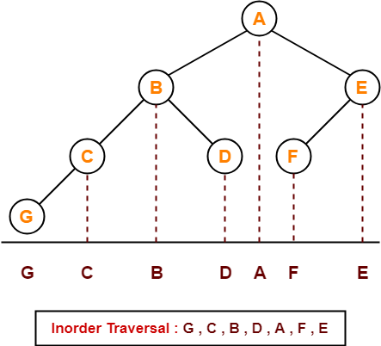
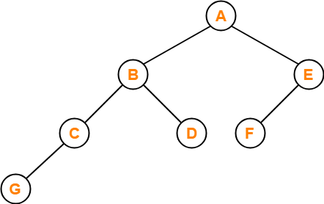
Problems on Tree Traversals
Problem – 1
If the binary tree in figure is traversed in inorder, then the order in which the nodes will be visited is ____?
Solution-
The inorder traversal will be performed as-

Slide 18
Problems on Tree Traversals
Problem – 2
Which of the following sequences denotes the post-order traversal sequence of the tree shown in figure?
1. FEGCBDBA
2. GCBDAFE
3. GCDBFEA
4. FDEGCBA
Solution-
Perform the post-order traversal by plucking all the leftmost leaf nodes one by one.
Then, Postorder Traversal is as follows
G , C , D , B , F , E , A
Thus, Option (3) is correct.

Slide 19
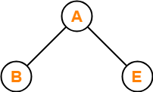
Problems on Tree Traversals
Problem – 3
Let LASTPOST, LASTIN, LASTPRE denote the last vertex visited in a post-order, in-order and preorder traversal respectively of a complete binary tree. Which of the following is always true?
1. LASTIN = LASTPOST
2. LASTIN = LASTPRE
3. LASTPRE = LASTPOST
4. None of these
Solution
Consider the following complete binary tree-
Pre-order Traversal : B , A , E
In-order Traversal : B , A , E
Post-order Traversal : B , E , A
Clearly, LASTIN = LASTPRE.
Thus, Option (2) is correct.

Slide 20
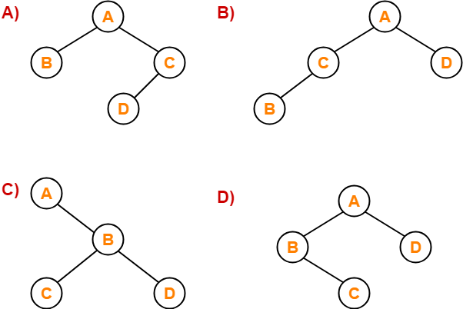
Problems on Tree Traversals
Problem – 4
Which of the following binary trees has its in-order and preorder traversals as BCAD and ABCD respectively-
Solution
Option (D) is correct

Slide 21
Non Recursive Pre-Order Traversals
Algorithm (Root - > Left Subtree – Right Sub Tree)
Following is a simple stack based iterative process to print Preorder traversal.
1) Create an empty stack nodeStack and push root node to stack.
2) Do following while nodeStack is not empty.
….a) Pop an item from stack and print it.
….b) Push right child of popped item to stack, if it is Not Null.
….c) Push left child of popped item to stack, if it is Not Null.
Note :- Right child is pushed before left child to make sure that left subtree is processed first.

Slide 22
Non Recursive In-Order Traversals
Algorithm (Left Subtree - Root - Right Sub Tree)
Create an empty stack S.
Initialize current node as root.
Push the current node to S and set current = current->left until current is NULL
If current is NULL and stack is not empty then
a) Pop the top item from stack.
b) Print the popped item, set current = popped_item->right
c) Go to step 3.
5) If current is NULL and stack is empty then we are done.

Slide 23
Non Recursive Post-Order Traversals
Algorithm (Left Subtree – Right Sub Tree - Root) – Single Stack
1.1 Create an empty stack.
2.1 Do following while root is not NULL
Push root's right child and then root to stack.
Set root as root's left child.
2.2 Pop an item from stack and set it as root.
If the popped item has a right child and the right child is at top of stack, then remove the right child from stack, push the root back and set root as root's right child.
Else print root's data and set root as NULL.
2.3 Repeat steps 2.1 and 2.2 while stack is not empty.

Slide 24
Non Recursive Post-Order Traversals
Algorithm (Left Subtree – Right Sub Tree - Root) – Double Stack
1. Create two empty stack i.e. Stack1 and Stack2.
2. Push root onto Stack1.
3. while stack1 is not empty
3.1. Pop item from stack1 and push it on Stack2.
3.2. Push left child of Popped Item into Stack1, if it is not NULL.
3.3. Push right child of Popped Item into Stack1, if it is not NULL.
3.4. Repeat through step 3.
4. Pop all items from stack2 and print it.

Slide 25
Breadth First Search Traversal / Level Order Printing
Algorithm
1. Create a empty Queue i.e. q.
2. Push root onto Queue i.e. q.push(root).
3. While q.size() > 0 do i.e. Queue is not empty()
3.1 Print the front() element from queue i.e. q.front().
3.2 Pop item from queue i.e. q.pop().
3.3 Push left of popped item on Queue i.e. q.push(left_Child), if it is not NULL.
3.4 Push right of popped item on Queue i.e. q.push(right_child), if it is not NULL.
3.5 Goto step 3
5. If q.size() = 0 , means all the nodes are printed.

Slide 26
Thank You

Slide 27
Breadth First Search Traversal / Level Order Printing
Algorithm
1. Create a empty Queue i.e. q.
2. Push root onto Queue i.e. q.push(root).
3. Initialize node_count with zero i.e. node_count=0;
4. while queue is not empty i.e. not of q.empty() do
4.1 Get the size of Queue i.e. node_count = q.size().
4.2 While q.size() > 0 do
4.2.1 Print the front() element from queue i.e. q.front().
4.2.2 Pop item from queue i.e. q.pop().
4.2.3 Push left of popped item on Queue i.e. q.push(left_Child), if it is not NULL.
4.2.4 Push right of popped item on Queue i.e. q.push(right_child), if it is not NULL.
4.2.5 Decrease node_count by 1 i.e. node_count--;
4.2.6 Goto step 4.2.
4.3. Goto step 4.
5. Done with.

Slide 28
Breadth First Search Traversal / Level Order Printing
Algorithm
1. Create a empty Queue i.e. q.
2. Push root onto Queue i.e. q.push(root).
3. Initialize node_count with zero i.e. node_count=0;
4. while queue is not empty i.e. not of q.empty() do
4.1 Get the size of Queue i.e. node_count = q.size().
4.2 While q.size() > 0 do
4.2.1 Print the front() element from queue i.e. q.front().
4.2.2 Pop item from queue i.e. q.pop().
4.2.3 Push left of popped item on Queue i.e. q.push(left_Child), if it is not NULL.
4.2.4 Push right of popped item on Queue i.e. q.push(right_child), if it is not NULL.
4.2.5 Decrease node_count by 1 i.e. node_count--;
4.2.6 Goto step 4.2.
4.3. Goto step 4.
5. Done with.

